Slide 1
Signed languages
“natural sign languages are autonomous linguistic systems, structurally independent of the spoken languages with which they may co-exist in a given community”

Slide 2
Signed languages
LOCATION
HAND SHAPE
FACIAL EXPRESSIONS

Slide 3
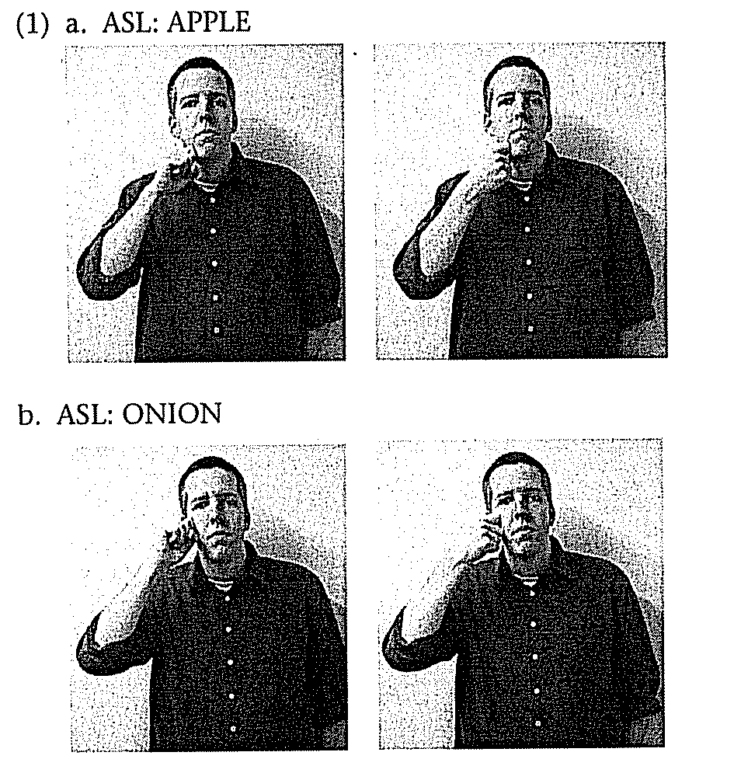
Location

Slide 4
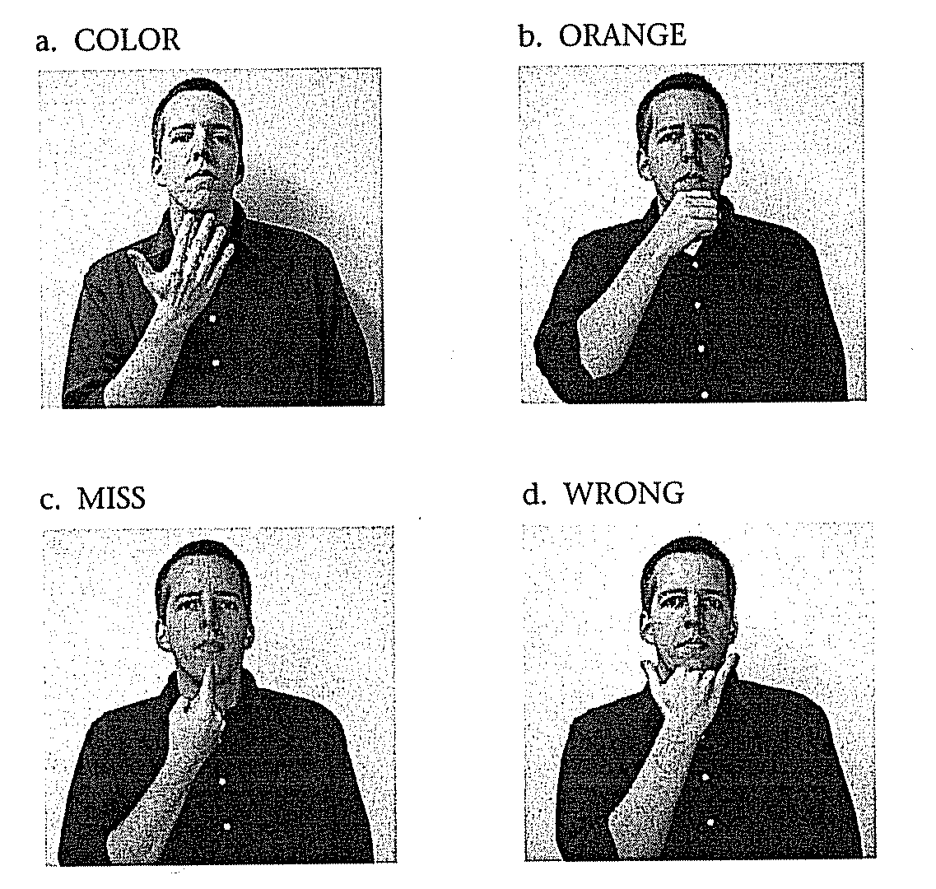
Hand shape

Slide 5
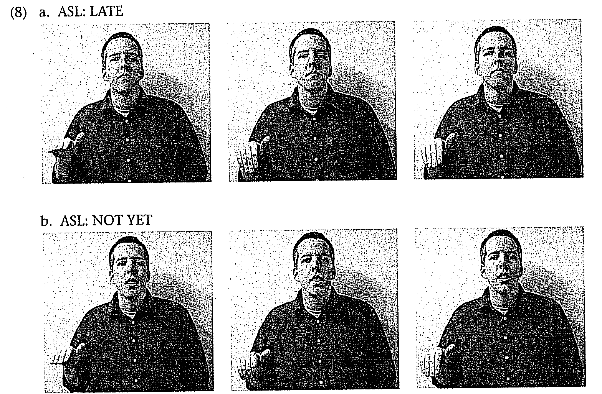
Facial Expressions

Slide 6
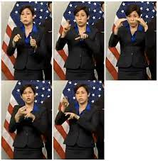
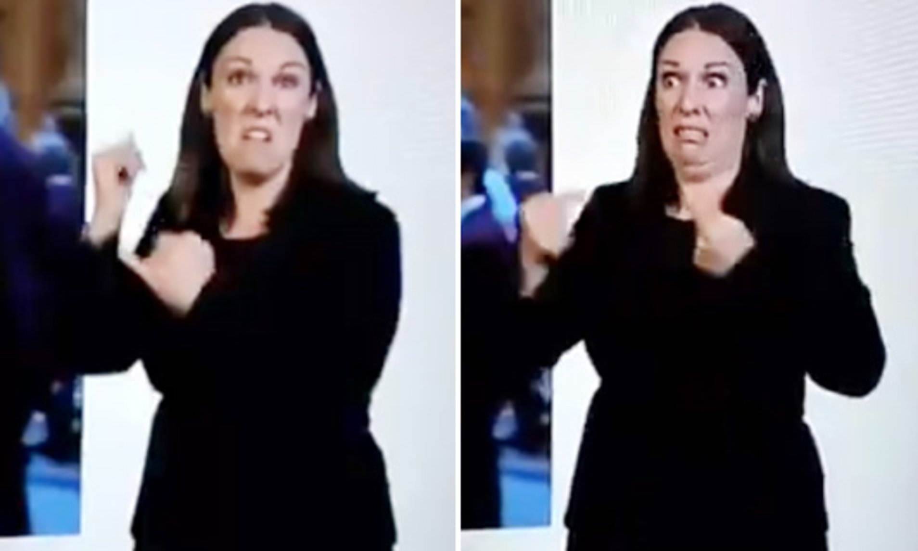

Slide 7
Signed vs. Spoken Language
Signs may be used to express complex propositions, unlike gestures
Signs contrast with each other, like words/sounds
Signed languages are processed similarly in the brain

Slide 8
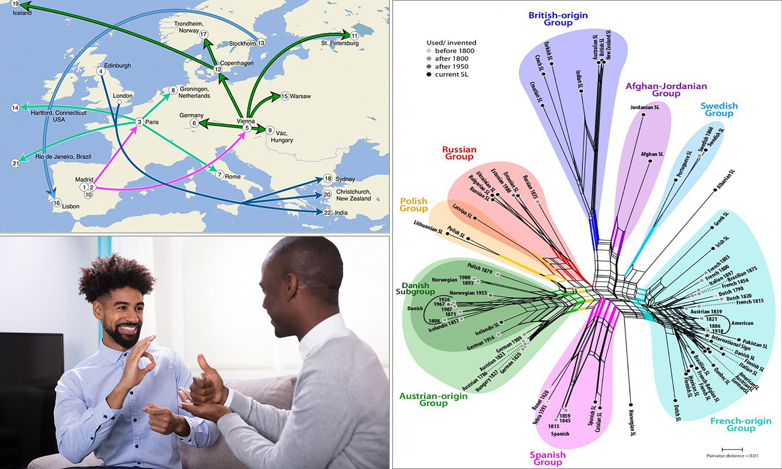

Slide 9
ASL

Slide 10
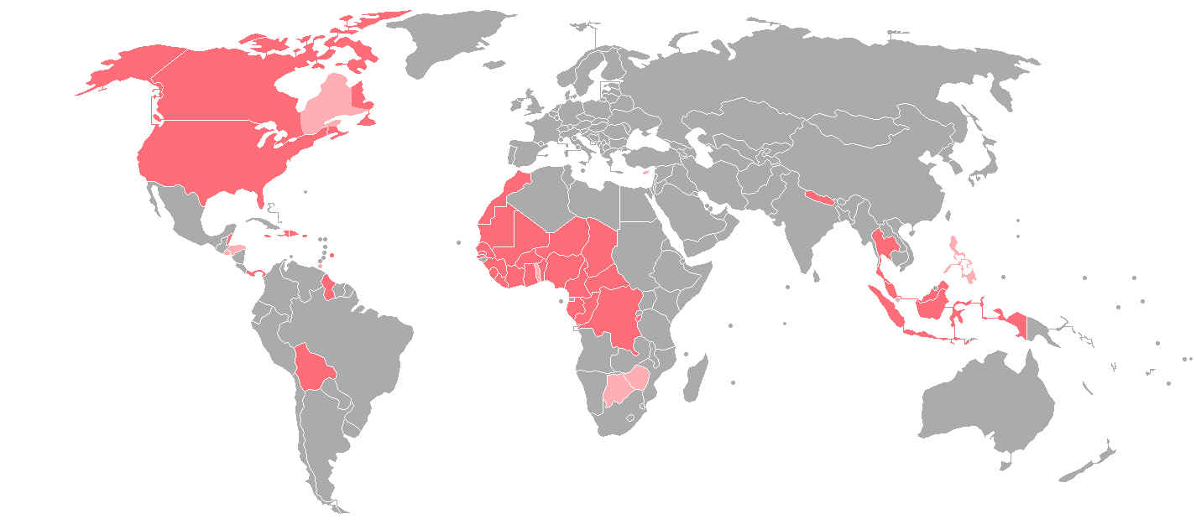
Where ASL is spoken

Slide 11
American Sign Language (ASL)
Population: 500,000 to 2 million (Schein 1989)
Developed at the American School for the Deaf in Connecticut (founded in 1817)
Strong influence from French Sign Language (FSL)
58% of ASL signs can be traced back to FSL origins
Also influenced by Martha’s Vineyard Sign Language
High percentage of deaf Islanders

Slide 12
Pause point 1
What did you know already about signed languages going into this reading?
Was it from personal experience, learning about it at school, or exposure on (social) media…?
Were there any misconceptions or misbeliefs you had about signed languages coming into this reading that were corrected or clarified by the article?

Slide 13
Discrimination against signers
ASL used to be banned in schools, and deaf children punished for signing
Racial segregation in Deaf schools lasted significantly longer than in hearing schools
Black and white deaf children were segregated up till the 1970s

Slide 14
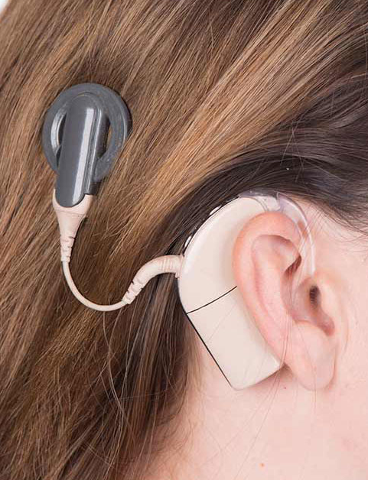
Discrimination against signers
Debate over whether or not deaf children should be taught to speak, be given cochlear implants, or learn only to sign

Slide 16
Pause point 2
Check out this essay about the viral videos of people (often babies) hearing for the first time due to cochlear implants (and go as far down the rabbithole as you’d like, since there are a number of additional videos & links on this page) and share with us your thoughts and reactions
What is audism? What is the case the author makes about these videos being an example of audism?
Does it deprive Deaf children of connection to Deaf culture to avoid teaching them a signed language and center on restoring their hearing ability?
What should we do when we see these videos circulating?
https://www.dailydot.com/irl/viral-videos-hearing-deaf-culture/

Slide 18
Variation in signing
There is variation in signing handshapes and movements just like spoken language features variation in pronunciation

Slide 20
Variation in ASL
One-handed vs. two-handed variants: DEER

Slide 21
Variation in ASL
Assimilation: TOMATO

Slide 22
Variation in ASL
Assimilation: TOMATO

Slide 23
Variation in ASL
Deletion: SNOW

Slide 25
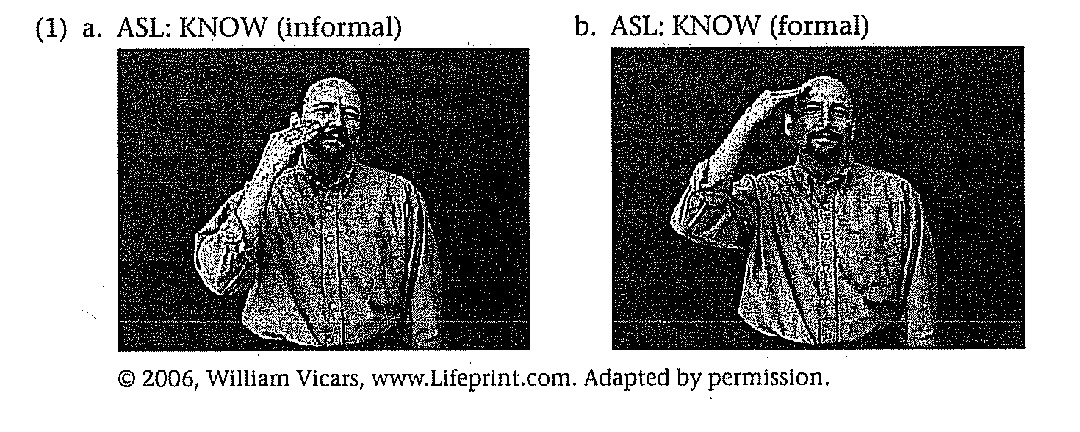
Variation in ASL
Variation based on formality (e.g. KNOW)

Slide 26
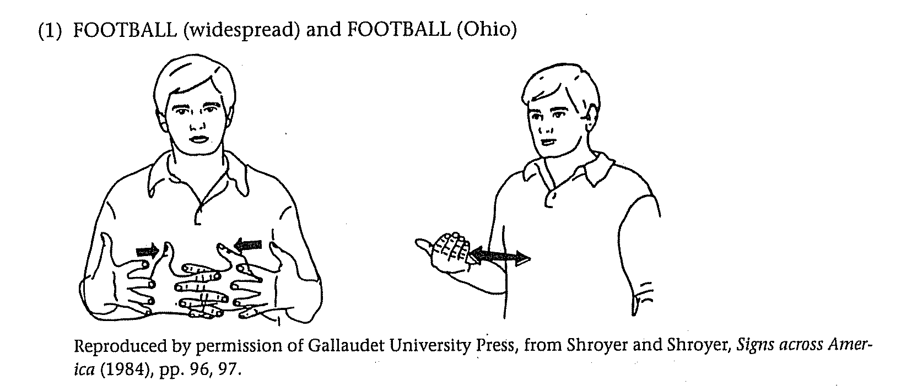
Variation in ASL
Regional variation (e.g. FOOTBALL)

Slide 27
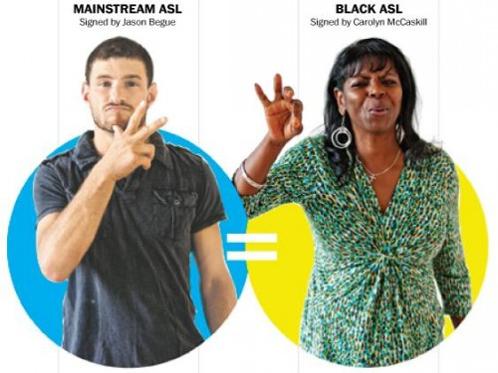
Variation in ASL
Ethnic variation (e.g. WELL-DRESSED)

Slide 28
Black ASL

Slide 29
Pause point 3
Find out more about Black ASL by reading one of these pieces, finding a Black signer on Tiktok (share the videos if you go this route!), googling “Carolyn McCaskill”, or watching Signing Black in America…
https://www.nytimes.com/2021/01/23/us/black-american-sign-language-tiktok.html
https://www.theatlantic.com/business/archive/2017/08/gallaudet-franklin-jones-carolyn-mccaskill/536949/
https://www.washingtonpost.com/lifestyle/style/sign-language-that-african-americans-use-is-different-from-that-of-whites/2012/09/17/
https://www.youtube.com/watch?v=oiLltM1tJ9M (Signing Black in America; run time ~30 mins)
What did you learn? What can you share? How did it align with, echo, or diverge from the points in the reading?

